Slide 1
Research on opening a new shopping mall in Helsinki, Finland by clustering neighbourhoods using Foursquare data
Final Capstone Project - IBM Data Science Professional Specialization
By Hien S. Nguyen, 07 May 2019

Slide 2
Project Introduction
Located on a peninsula in the Gulf of Finland, Helsinki is the Capital of Finland and the centre of the Helsinki Region with over 600,000 inhabitants. As the city grows and develops, it becomes increasingly important to examine and understand it quantitatively.
Objective: to analyse and explore the best locations in the city of Helsinki to open a new shopping mall. By following data science methodology and applying Clustering technique, this project aims to provide solutions to answer the following business questions:
Where is the potential area to open a shopping mall?
How many potential areas are in Helsinki?
Which areas do they share similar characteristics to each other?

Slide 3
Data
Data required
List of neighbourhoods in Helsinki, Finland
Latitude and longitude coordinates of those neighbourhoods. This is required in order to plot the map and also to get the venue data.
Venue data, particularly data related to shopping malls. We will use this data to perform clustering on the neighbourhoods.
Data sources
List of Helsinki Neighbourhoods https://en.wikipedia.org/wiki/Category:Neighbourhoods_of_Helsinki
Longtitude & Latitude coordinates of Helsinki Neighbourhoods from Python Geocoder Library
Venue data associated to the neighbourhoods from Foursquare Developer: https://developer.foursquare.com

Slide 4
Methodology
Build a dataframe of neighborhoods in Helsinki, Finland by web scraping the data from Wikipedia page
Get the geographical coordinates of the neighborhoods
Obtain the venue data for the neighborhoods from Foursquare API
Perform k-means statisical analysis on venues by locations of interest based on findings from the neighbourhoods
Select the best cluster to open a new shopping mall

Slide 5
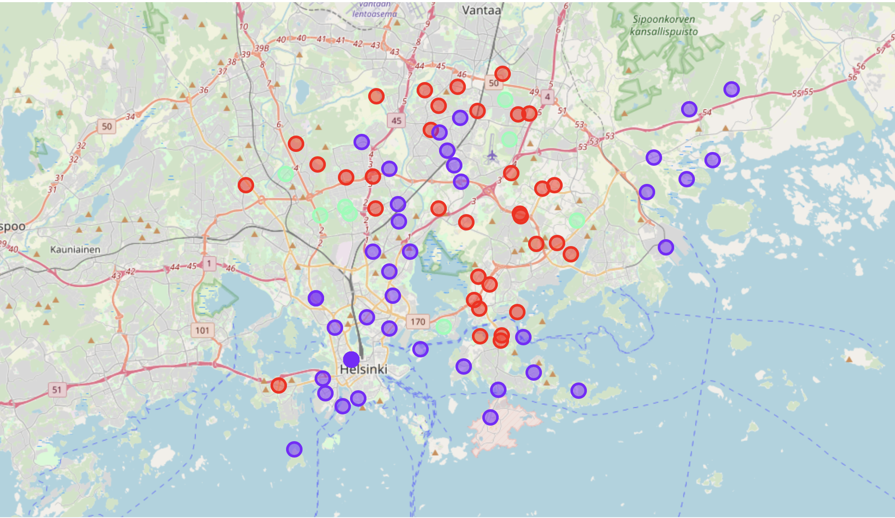
Result
The results from the k-means clustering show that we can categorize the neighbourhoods into 3 clusters based on the frequency of occurrence for “Shopping Mall”:
Cluster 0 (Red): Neighbourhoods with moderate number of shopping malls
Cluster 1 (Purple): Neighbourhoods with high concentration of shopping malls
Cluster 2 (Green): Neighbourhoods with low number to no existence of shopping malls

Slide 6
Discussion
As observations noted from the map in the Results section, most of the shopping malls are concentrated in the central area of Helsinki city, with the highest number in cluster 1 and moderate number in cluster 0. On the other hand, cluster 2 has very low number to no shopping mall in the neighbourhoods. This represents a great opportunity and high potential areas to open new shopping malls as there is very little to no competition from existing malls.
Meanwhile, shopping malls in cluster 1 are likely suffering from intense competition due to oversupply and high concentration of shopping malls. From another perspective, the results also show that the oversupply of shopping malls mostly happened in the central area of the city, with the suburb area still have very few shopping malls.

Slide 7
Recommendations
Therefore, this project recommends property developers to capitalize on these findings to open new shopping malls in neighbourhoods in cluster 2 with little to no competition. Property developers with unique selling propositions to stand out from the competition can also open new shopping malls in neighbourhoods in cluster 0 with moderate competition. Lastly, property developers are advised to avoid neighbourhoods in cluster 1 which already have high concentration of shopping malls and suffering from intense competition.

